Slide 1
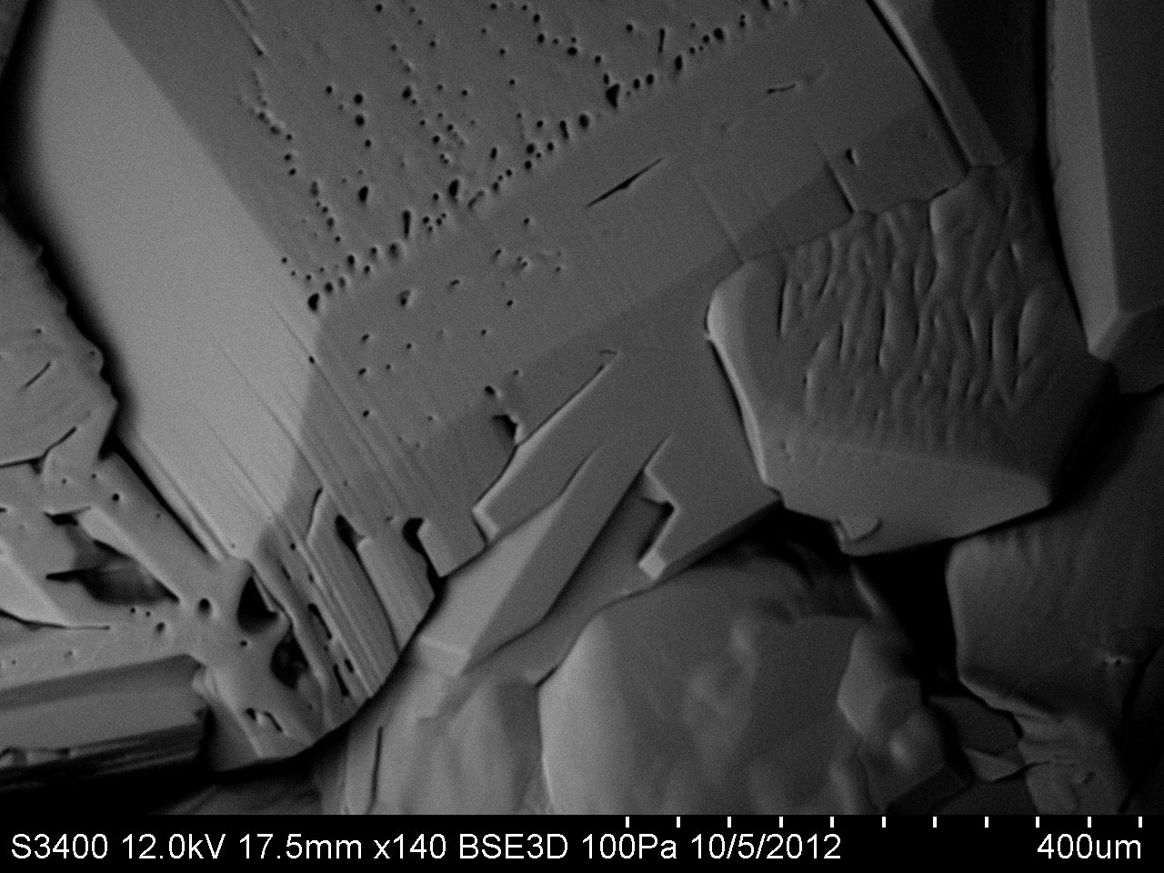

Ice is complicated
$$mesoscopic scale$$
(from scanning electron microscopy)
Part I:
How do surfaces get rough? Actually, how do surfaces remain smooth?
Part II:
What controls the roughness? Actually, what is roughness?
Molecular scale

Slide 2
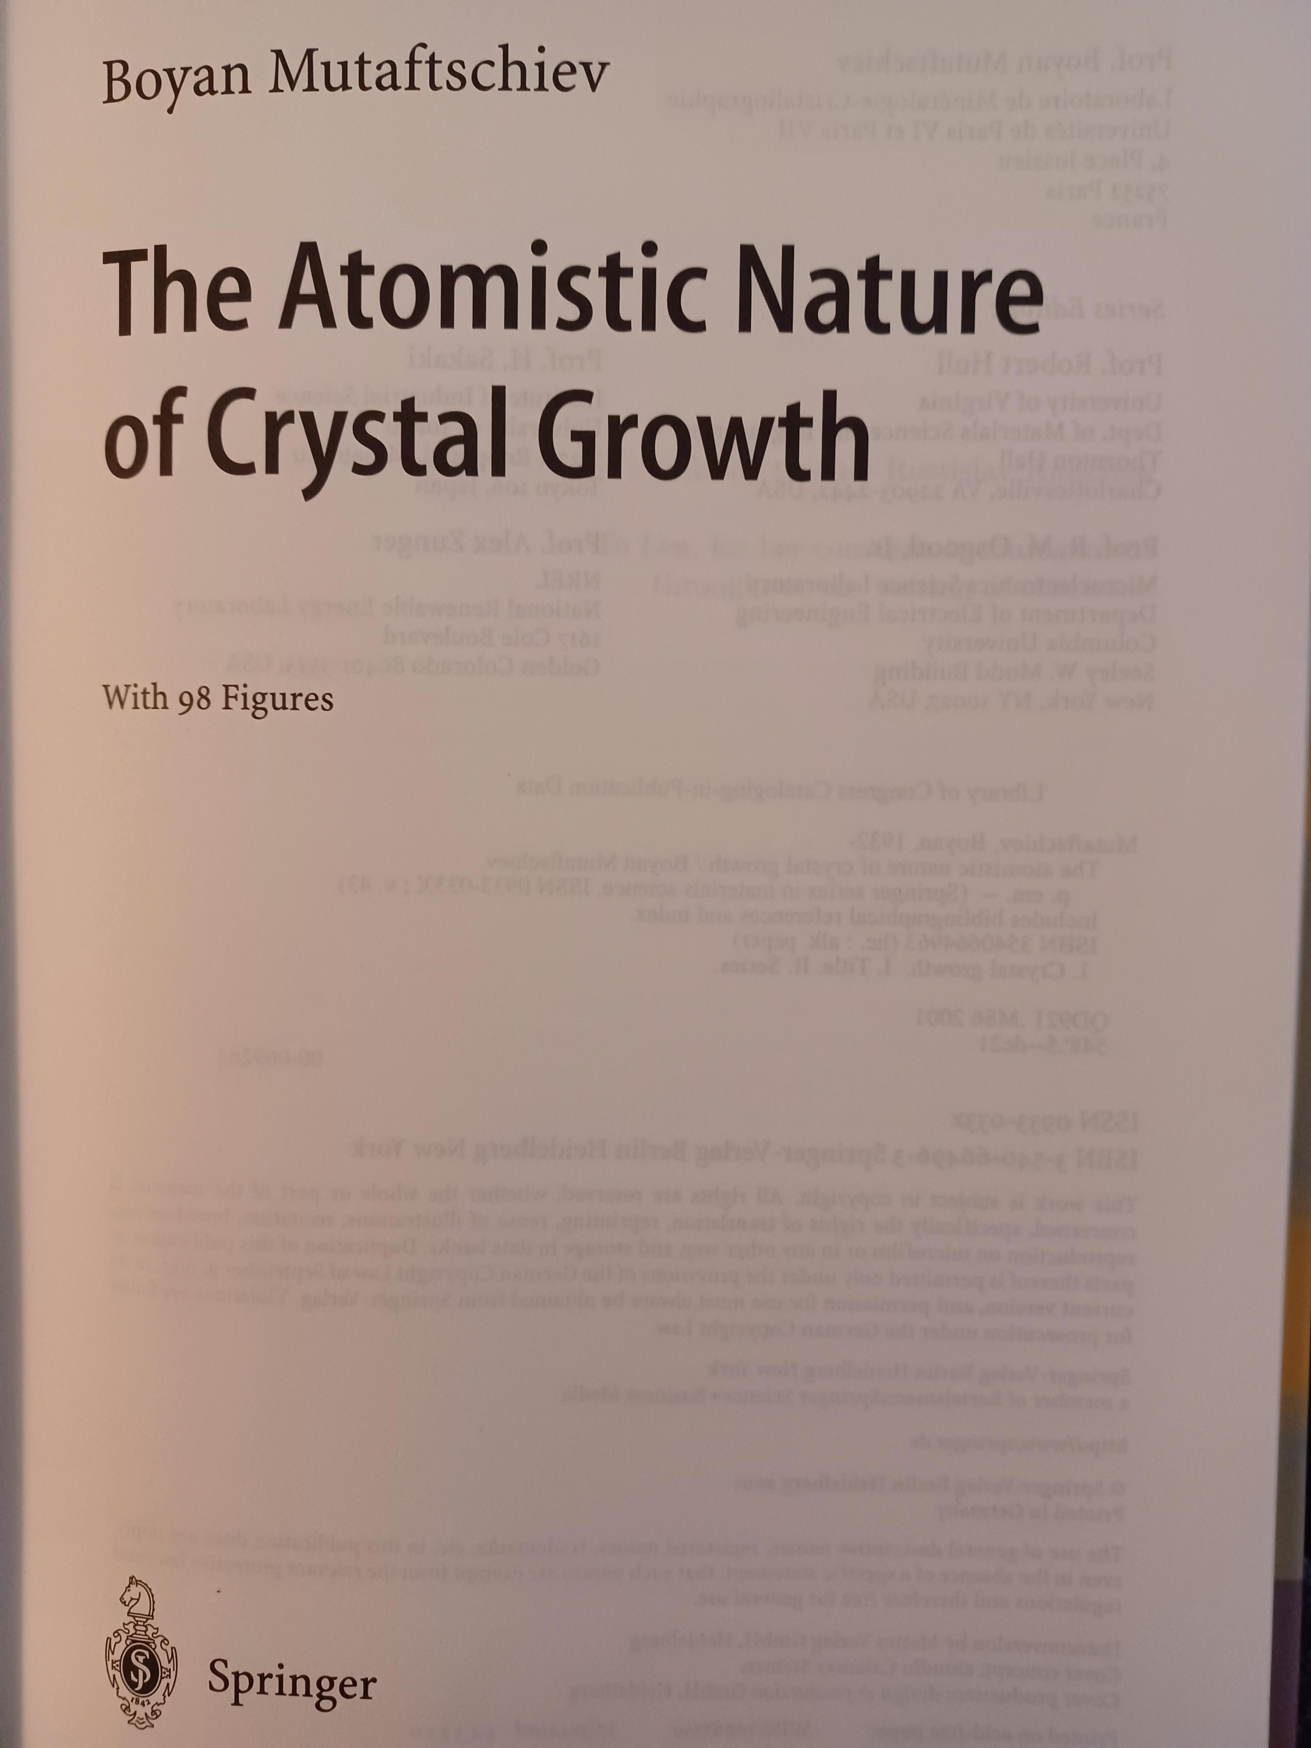
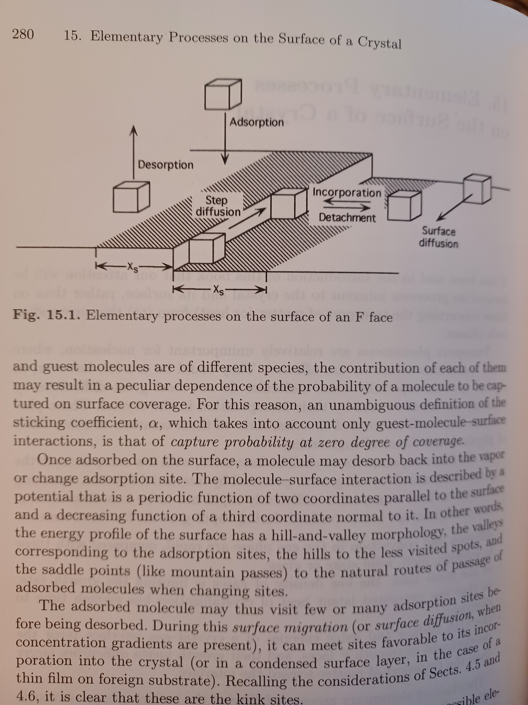
We’d like to describe these behaviors in a way pioneered by BCF (and others) …

Slide 3
We’d like to describe these behaviors in a way pioneered by BCF (and others) …
… But we can’t because of the pesky quasi-liquid layer

Slide 4
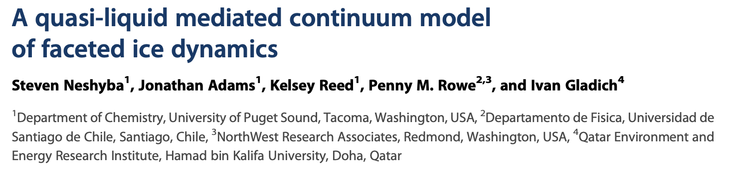
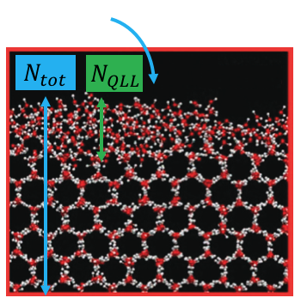
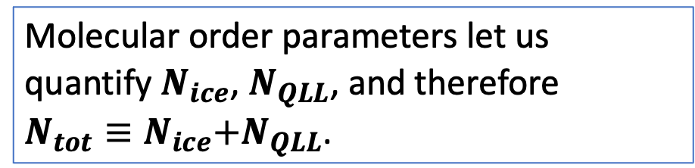
Molecular Dynamics studies of the QLL of water ice
prismatic surface
prismatic surface
Molecular order parameters let us quantify $N_{ice}$, $N_{QLL}$, and therefore
$N_{tot}≡N_{ice}\text{+}N_{QLL}\text{.}$
basal surface
We have a mathematical criterion

Slide 5
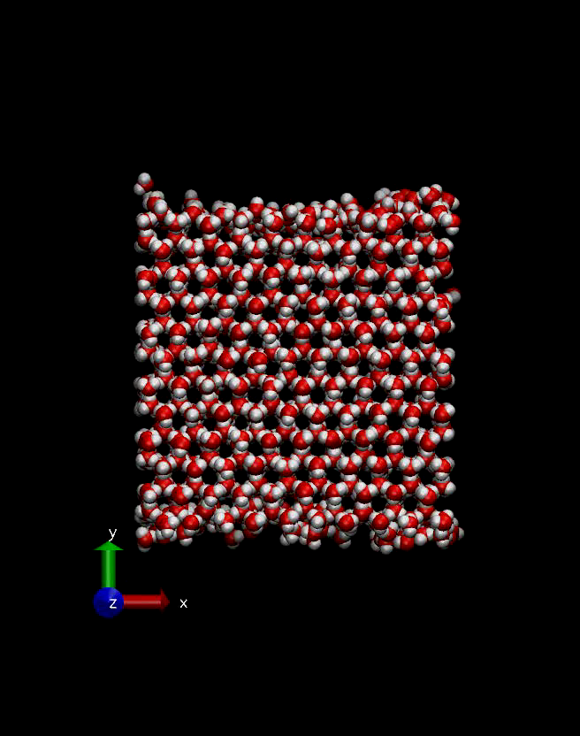
Here are the kind of numerical experiments we did
The time for this simulation is picoseconds, but after a few nanoseconds, we could get “equilibrium” thicknesses of the QLL.
basal surface
We have a mathematical criterion

Slide 6
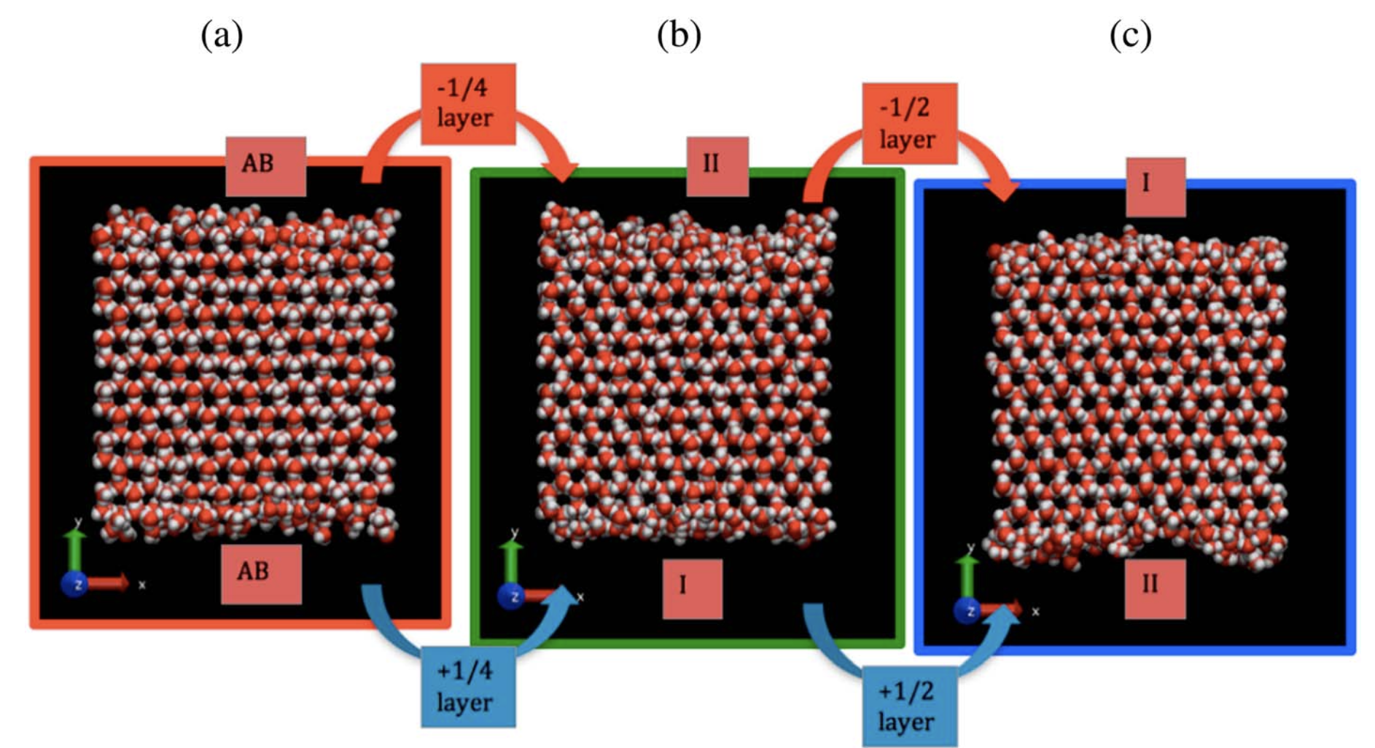
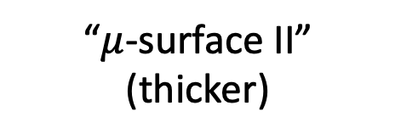
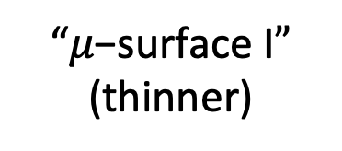
We found a periodic variation in $N_{QLL}^{eq}$ as a function of $N_{tot}$
“$μ\text{−}\text{surface} \text{I}”$
(thinner)
“$μ$-surface II”
(thicker)

Slide 7
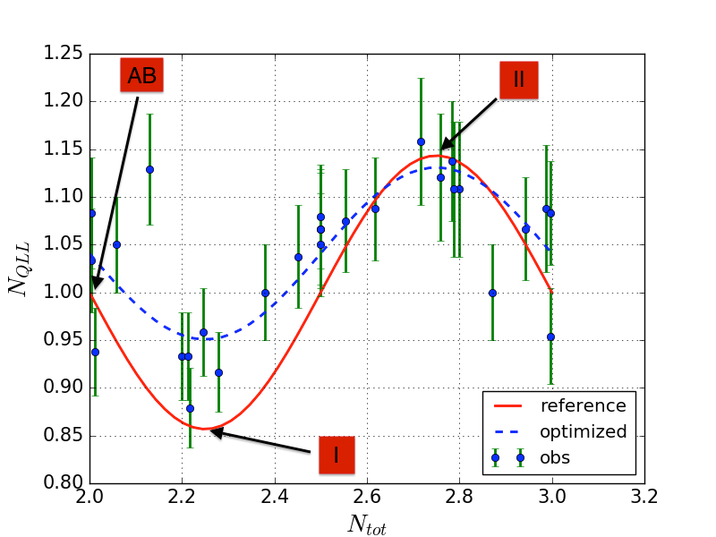
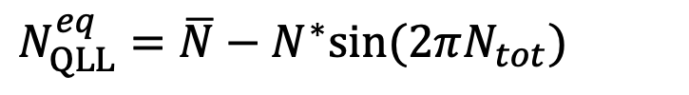
A rough description of that periodicity: a simple sinusoidal function of $N_{tot}$
$N_{QLL}^{eq}=\overline{N}−N^{∗}sin⁡(2πN_{tot})$

Slide 8
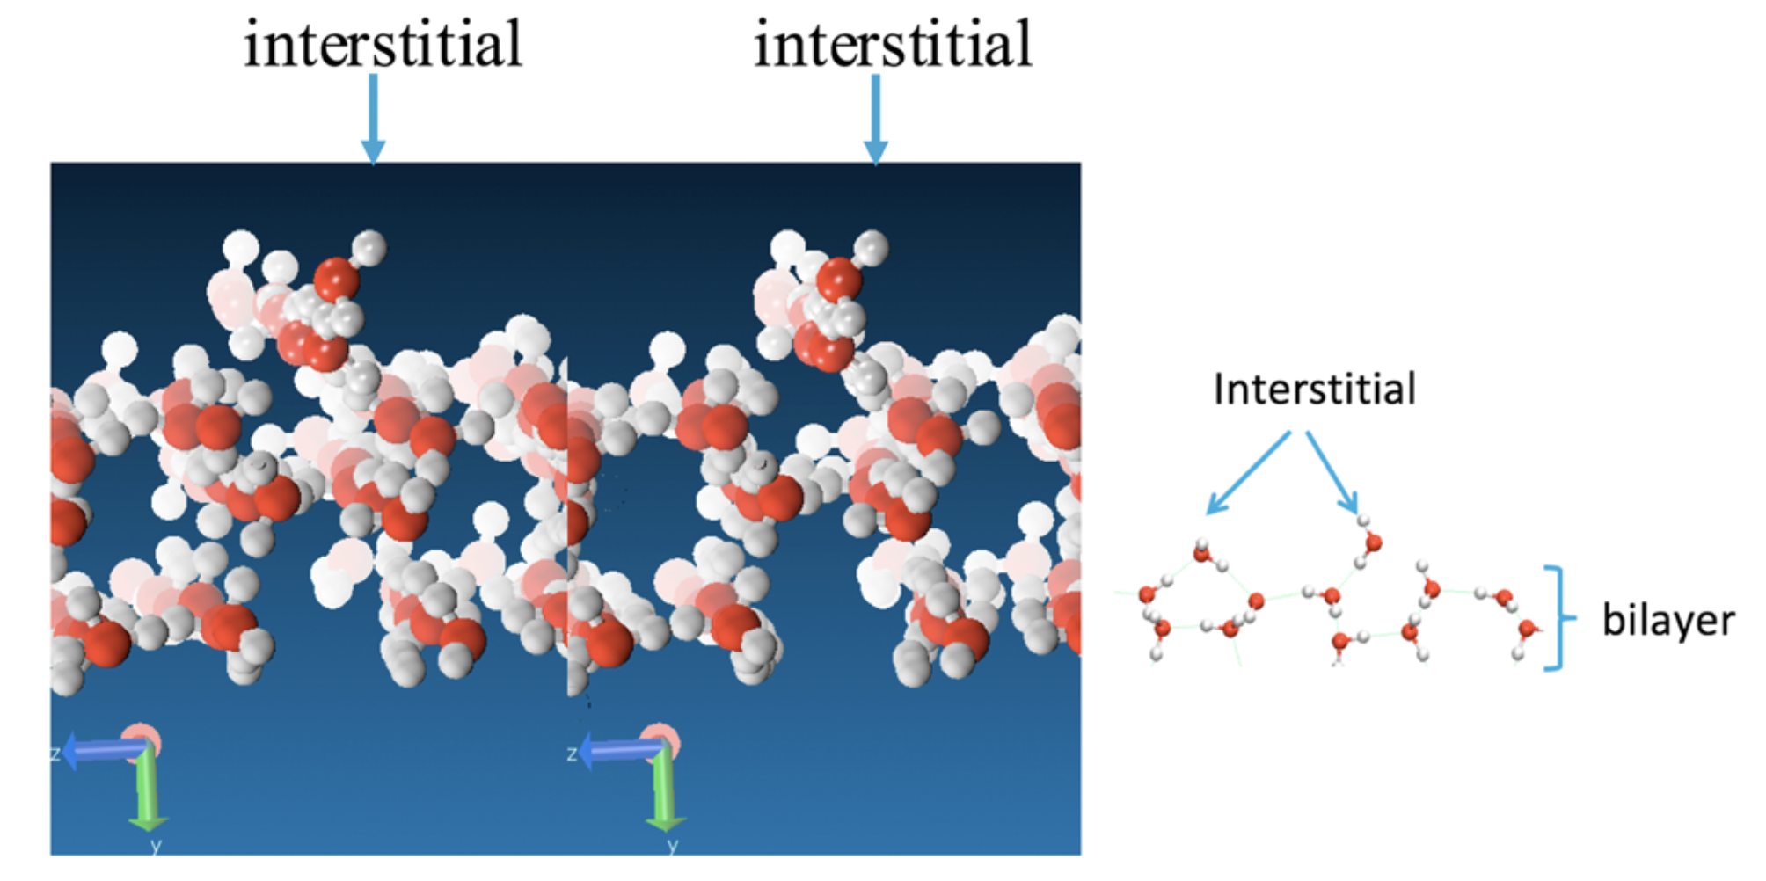
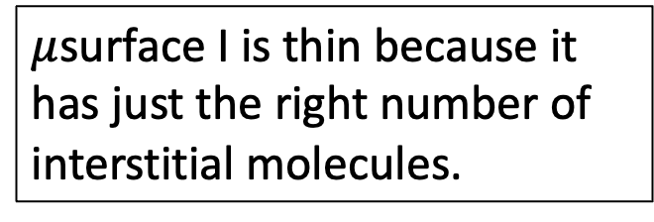
We also think we understood why $μ$surface I is thin
$μ$surface I is thin because it has just the right number of interstitial molecules.

Slide 9
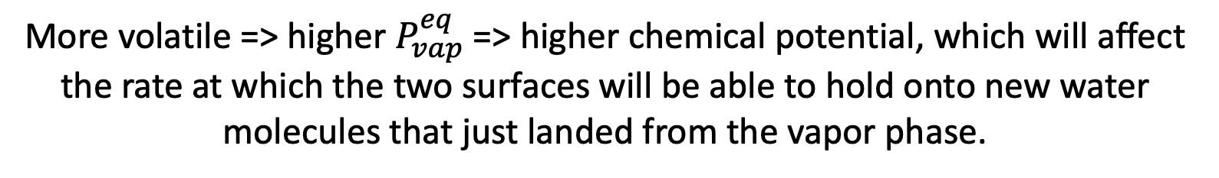


The same simulations also predicted that $μ$surface II is more volatile
$μ$surface II
$μ$surface I
More volatile => higher $P_{vap}^{eq}$ => higher chemical potential, which will affect the rate at which the two surfaces will be able to hold onto new water molecules that just landed from the vapor phase.

Slide 10
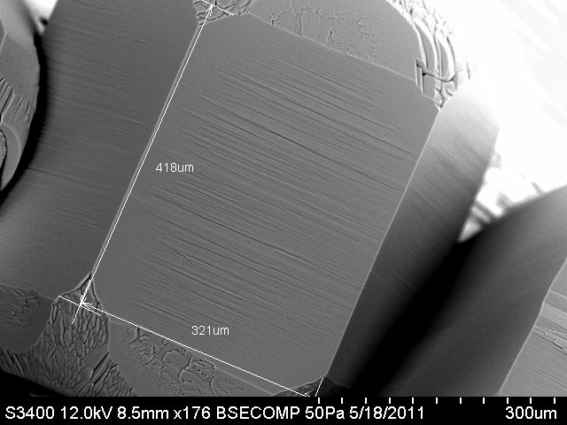
Scaling up from the MD scale to the mesoscale (or SEM scale) in a way that keeps all those insights (but lets go of the details) requires a continuum model of some kind

Slide 11
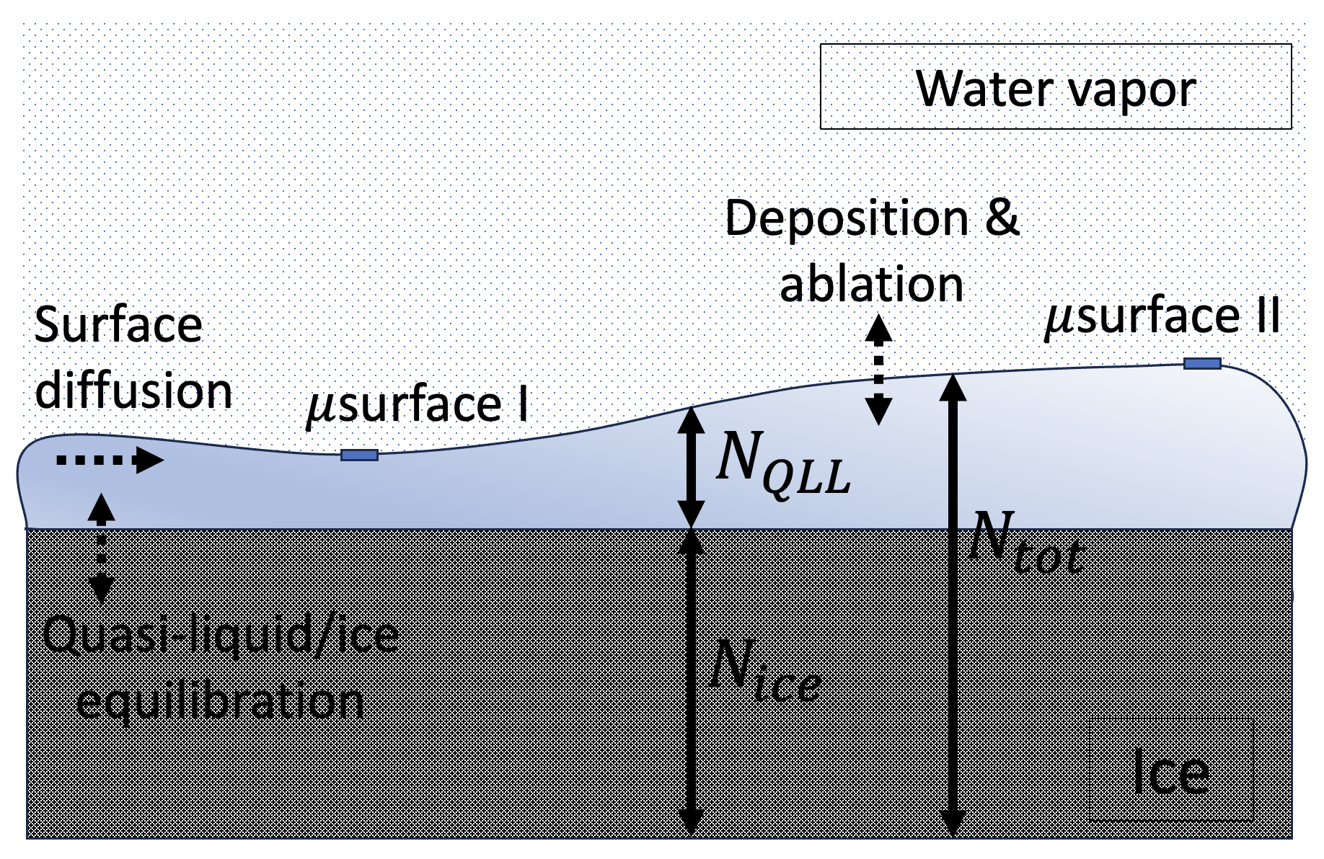
BCF-like processes we’d like to retain in our continuum model

Slide 12
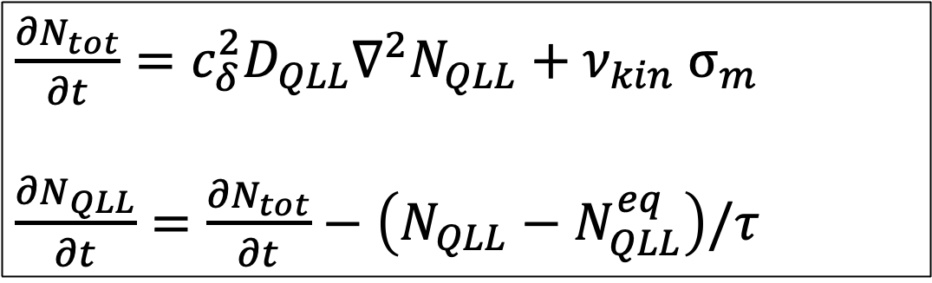
We’ll use two coupled PDEs to represent those processes
$\frac{{∂N}_{tot}}{∂t}={c_{δ}^{2}D}_{QLL}∇^{2}N_{QLL}+ν_{kin}$ $σ_{m}$
$\frac{{∂N}_{QLL}}{∂t}=\frac{{∂N}_{tot}}{∂t}−\left(N_{QLL}−N_{QLL}^{eq}\right)/τ$

Slide 13
Surface diffusion of the QLL
$\frac{{∂N}_{tot}}{∂t}={c_{δ}^{2}D}_{QLL}∇^{2}N_{QLL}+ν_{kin} σ_{m}$
$\frac{{∂N}_{QLL}}{∂t}=\frac{{∂N}_{tot}}{∂t}−\left(N_{QLL}−N_{QLL}^{eq}\right)/τ$

Slide 14
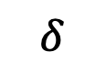
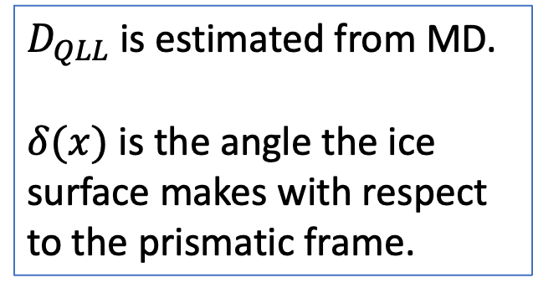
Surface diffusion of the QLL
$\frac{{∂N}_{tot}}{∂t}={c_{δ}^{2}D}_{QLL}∇^{2}N_{QLL}+ν_{kin} σ_{m}$
$\frac{{∂N}_{QLL}}{∂t}=\frac{{∂N}_{tot}}{∂t}−\left(N_{QLL}−N_{QLL}^{eq}\right)/τ$
$D_{QLL}$ is estimated from MD.
$δ(x)$ is the angle the ice surface makes with respect to the prismatic frame.
$$δ$$

Slide 15
Interconversion of quasi-liquid with the underlying ice lattice
$\frac{{∂N}_{tot}}{∂t}={c_{δ}^{2}D}_{QLL}∇^{2}N_{QLL}+ν_{kin} σ_{m}$
$\frac{{∂N}_{QLL}}{∂t}=\frac{{∂N}_{tot}}{∂t}−\left(N_{QLL}−N_{QLL}^{eq}\right)/τ$

Slide 16
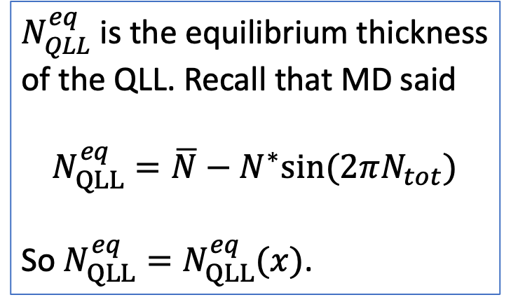
Interconversion of quasi-liquid with the underlying ice lattice
$\frac{{∂N}_{tot}}{∂t}={c_{δ}^{2}D}_{QLL}∇^{2}N_{QLL}+ν_{kin} σ_{m}$
$\frac{{∂N}_{QLL}}{∂t}=\frac{{∂N}_{tot}}{∂t}−\left(N_{QLL}−N_{QLL}^{eq}\right)/τ$
$N_{QLL}^{eq}$ is the equilibrium thickness of the QLL. Recall that MD said
$$N_{QLL}^{eq}=\overline{N}−N^{∗}sin⁡(2πN_{tot})$$
So $N_{QLL}^{eq}=N_{QLL}^{eq}(x)$.

Slide 17
Exchange with the overlying water vapor
$\frac{{∂N}_{tot}}{∂t}={c_{δ}^{2}D}_{QLL}∇^{2}N_{QLL}+ν_{kin} σ_{m}$
$\frac{{∂N}_{QLL}}{∂t}=\frac{{∂N}_{tot}}{∂t}−\left(N_{QLL}−N_{QLL}^{eq}\right)/τ$

Slide 18
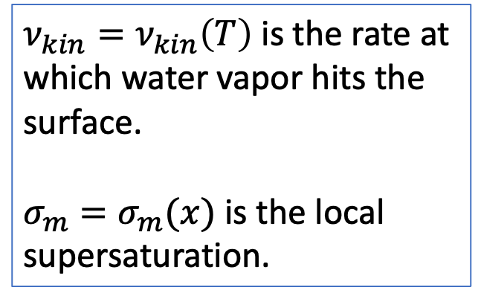
Exchange with the overlying water vapor
$\frac{{∂N}_{tot}}{∂t}={c_{δ}^{2}D}_{QLL}∇^{2}N_{QLL}+ν_{kin} σ_{m}$
$\frac{{∂N}_{QLL}}{∂t}=\frac{{∂N}_{tot}}{∂t}−\left(N_{QLL}−N_{QLL}^{eq}\right)/τ$
$ν_{kin}=ν_{kin}\left(T\right)$ is the rate at which water vapor hits the surface.
$σ_{m}=σ_{m}(x)$ is the local supersaturation.

Slide 19


A little more explanation of $σ_{m}$ … it depends on the overlying vapor pressure
Higher $P_{vap}$
Ice crystal
(2D)

Slide 20
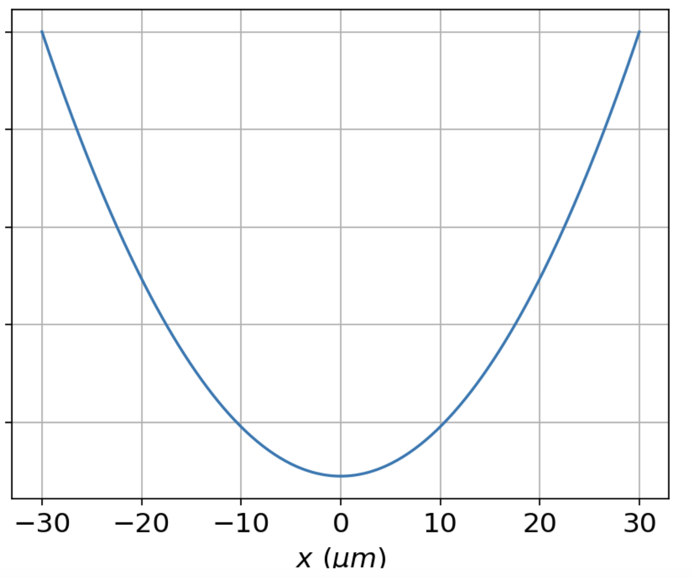
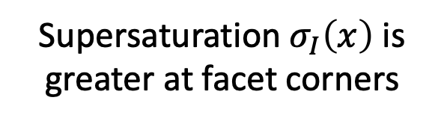
That overlying vapor pressure defines a supersaturation term, $σ_{I}(x)$
Higher $P_{vap}$
Supersaturation $σ_{I}\left(x\right)$ is greater at facet corners
Ice crystal
(2D)

Slide 21
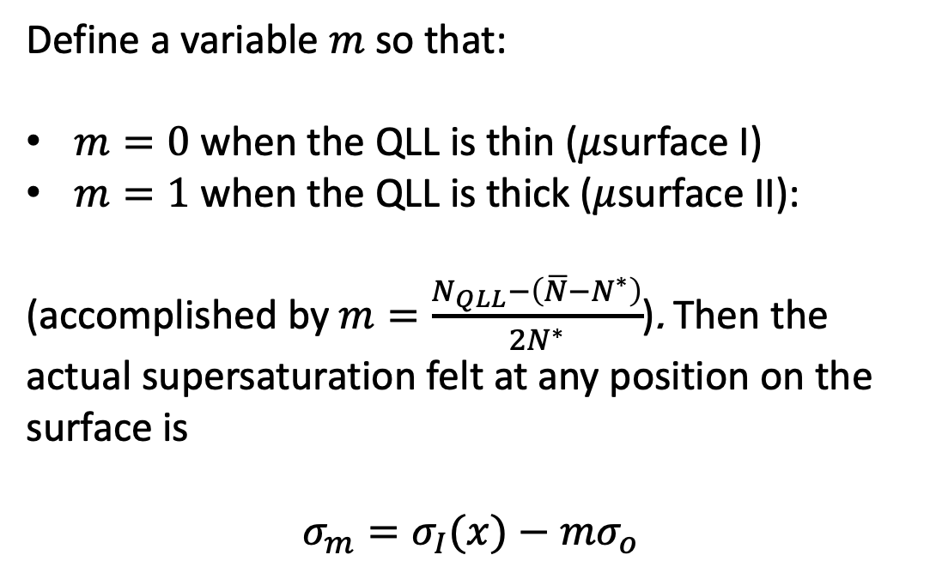
But $σ_{m}$ also depends on the volatility of the QLL
Higher $P_{vap}$
Define a variable $m$ so that:
$m=0$ when the QLL is thin ($μ$surface I)
$m=1$ when the QLL is thick ($μ$surface II):
(accomplished by $m=\frac{N_{QLL}−\left(\overline{N}−N^{∗}\right)}{2N^{∗}}$). Then the actual supersaturation felt at any position on the surface is
$$σ_{m}=σ_{I}(x)−mσ_{o}$$
Ice crystal
(2D)

Slide 22
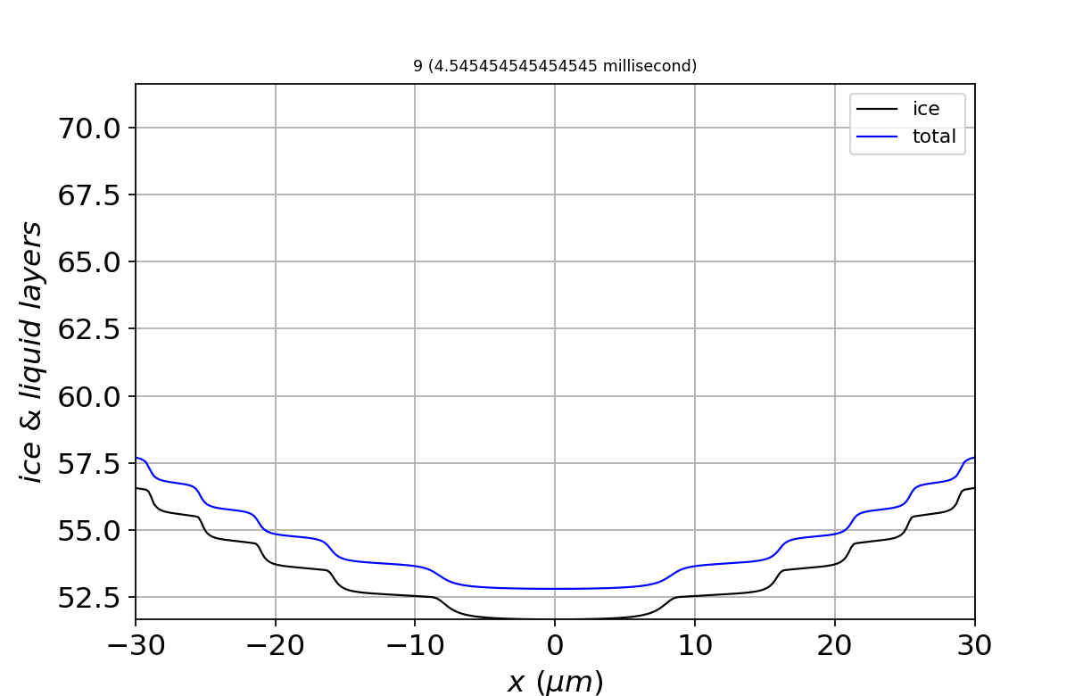
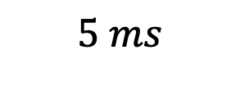
OK, let’s look at some results – solving the PDE starting with a flat surface
Higher $P_{vap}$
$$5 ms$$
Ice crystal
(2D)

Slide 23
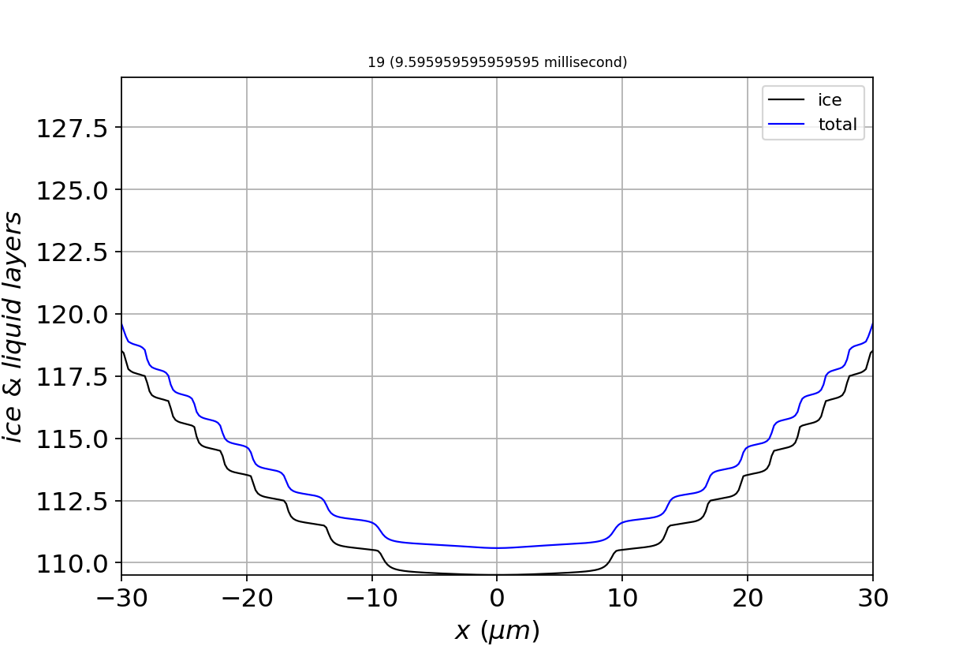
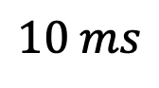
OK, let’s look at some results – solving the PDE starting with a flat surface
Higher $P_{vap}$
$$10 ms$$
Ice crystal
(2D)

Slide 24
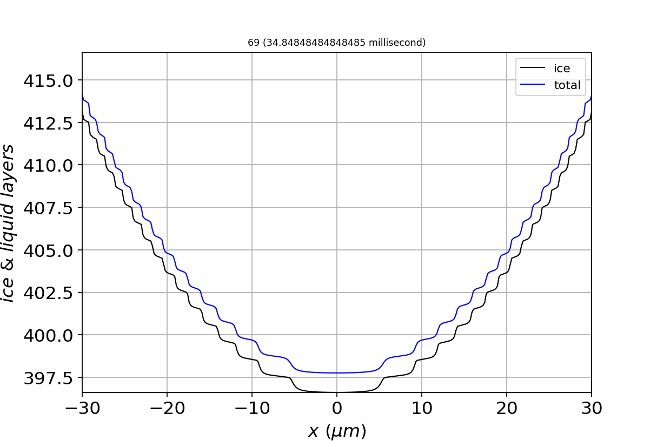
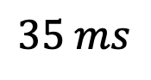
OK, let’s look at some results – solving the PDE starting with a flat surface
Higher $P_{vap}$
$$35 ms$$
Ice crystal
(2D)

Slide 25
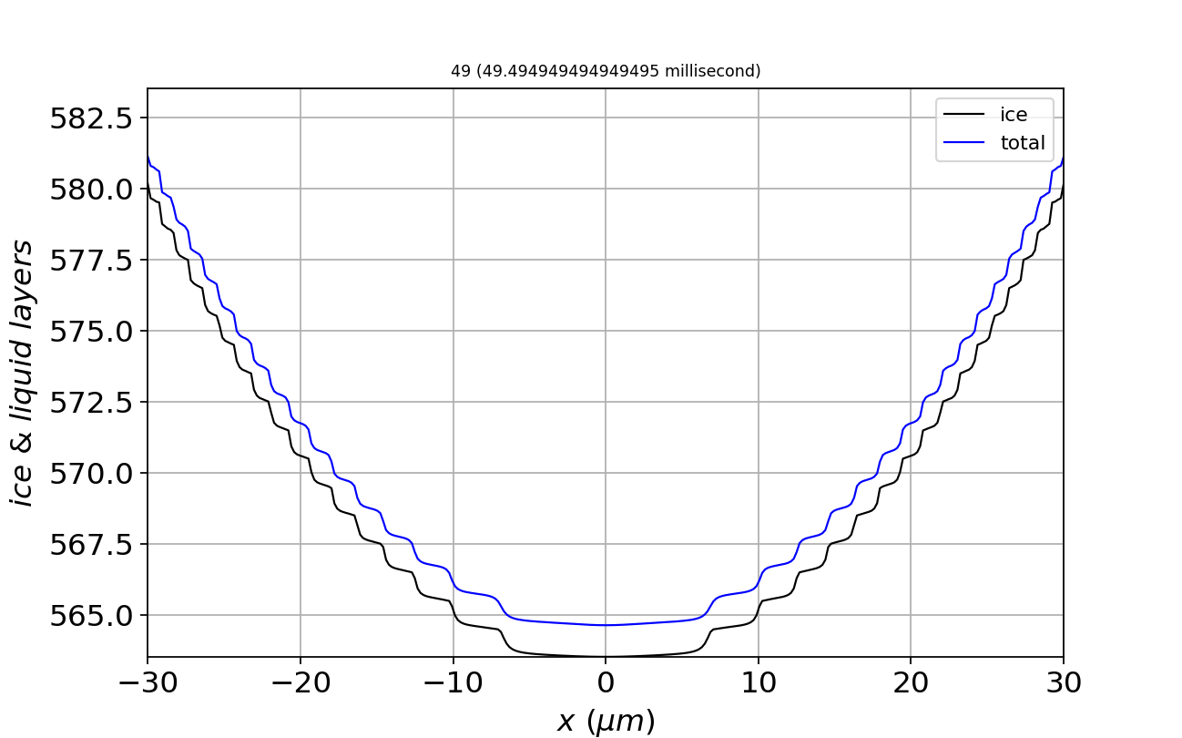
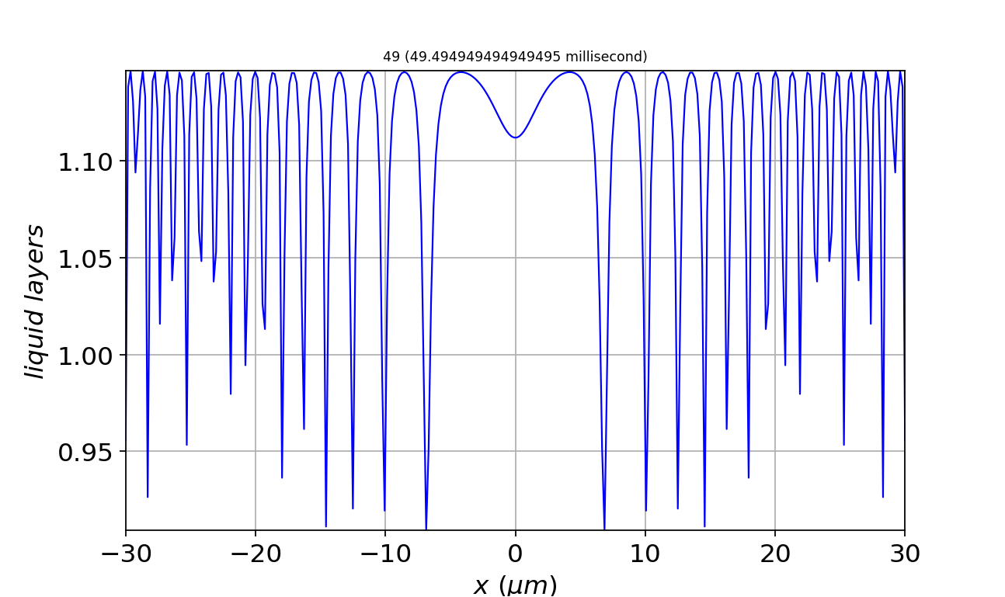
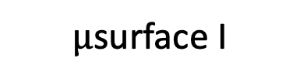
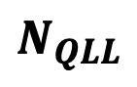
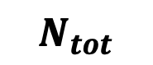
Steps are characterized by thin quasiliquid (i.e., $μ$surface I)
$μ$surface I
$$N_{tot}$$
$$N_{QLL}$$

Slide 26
Steps are characterized by thin quasiliquid (i.e., $μ$surface I)
$μ$surface I
$$N_{tot}$$
$$N_{QLL}$$

Slide 27
Steps are characterized by thin quasiliquid (i.e., $μ$surface I)
$μ$surface I
$$N_{tot}$$
$$N_{QLL}$$

Slide 28
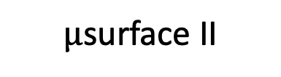
Terraces are characterized by thick quasiliquid (i.e., $μ$surface II)
$μ$surface II
$$N_{tot}$$
$$N_{QLL}$$

Slide 29
Terraces are characterized by thick quasiliquid (i.e., $μ$surface II)
$μ$surface II
$$N_{tot}$$
$$N_{QLL}$$

Slide 30
Terraces are characterized by thick quasiliquid (i.e., $μ$surface II)
$μ$surface II
$$N_{tot}$$
$$N_{QLL}$$

Slide 31
Recap: steps are mainly $μ$surface I

Slide 32
Recap: terraces are mainly $μ$surface II

Slide 33
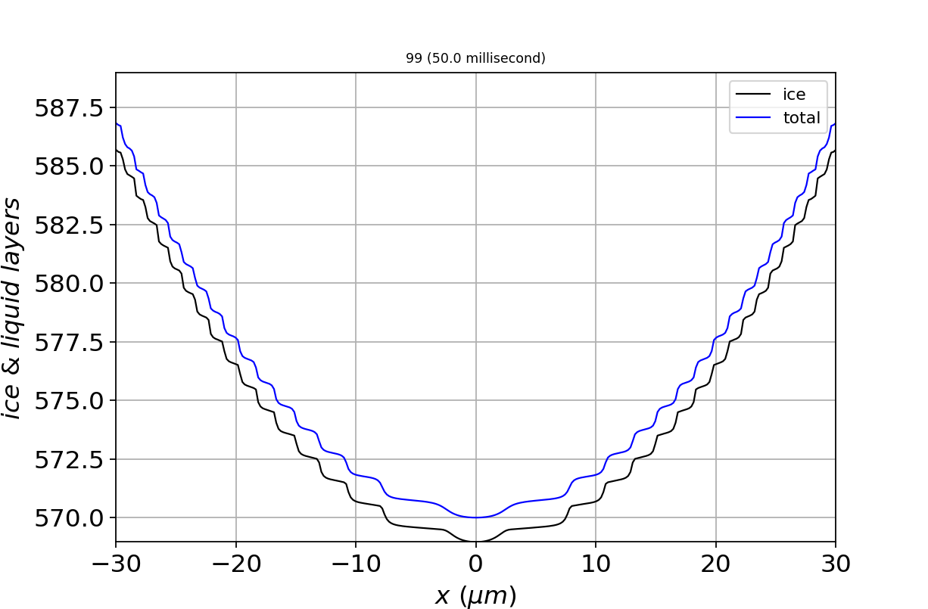
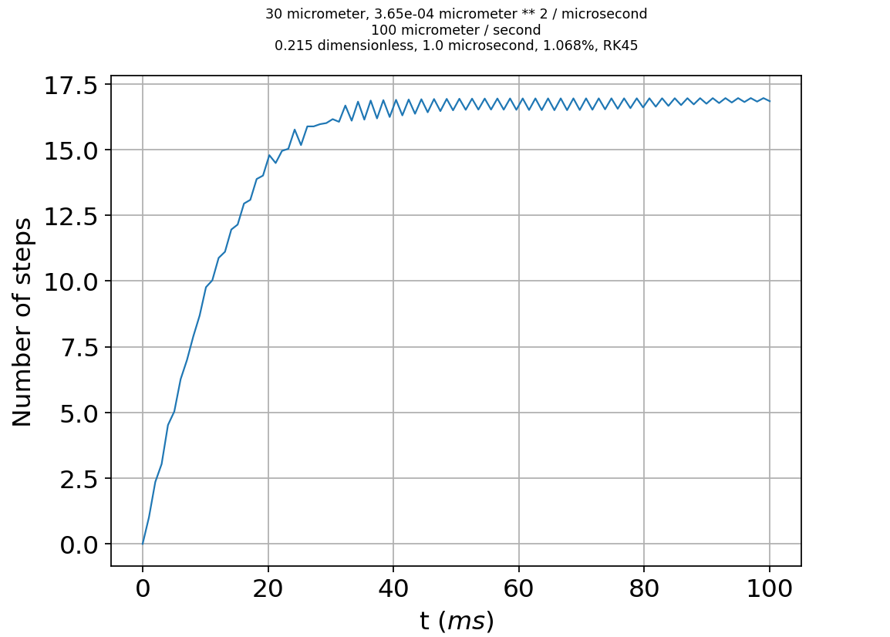
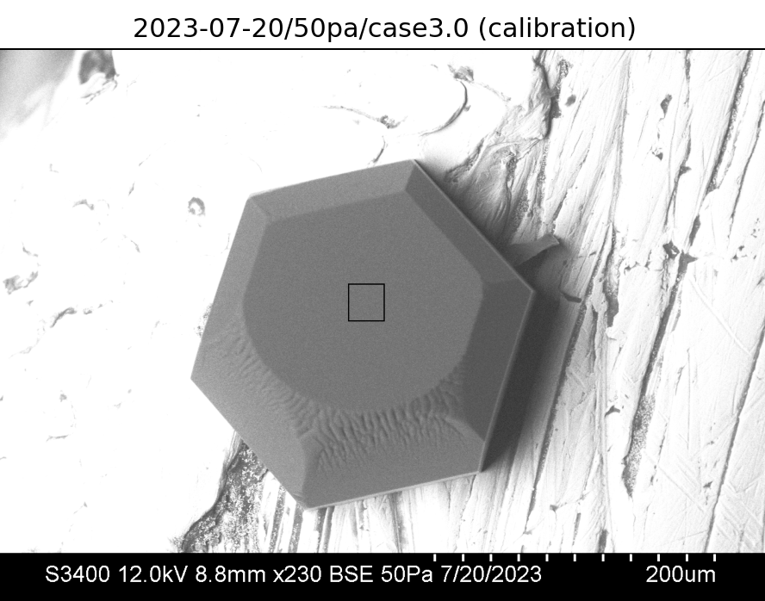
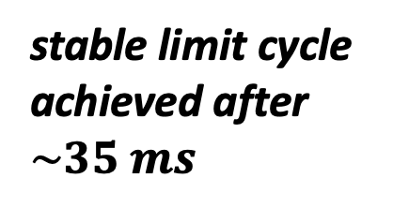
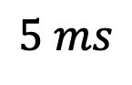
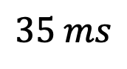
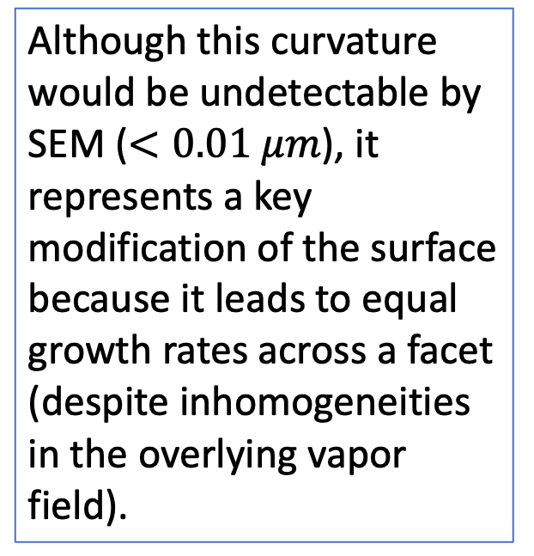
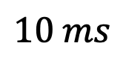
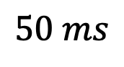
A big surprise: some parameters lead to stable limit cycles (like a steady state)
$$5 ms$$
$$10 ms$$
$$35 ms$$
$$50 ms$$
Although this curvature would be undetectable by SEM ($<0.01 μm$), it represents a key modification of the surface because it leads to equal growth rates across a facet (despite inhomogeneities in the overlying vapor field).
stable limit cycle achieved after $\sim 35 ms$

Slide 34
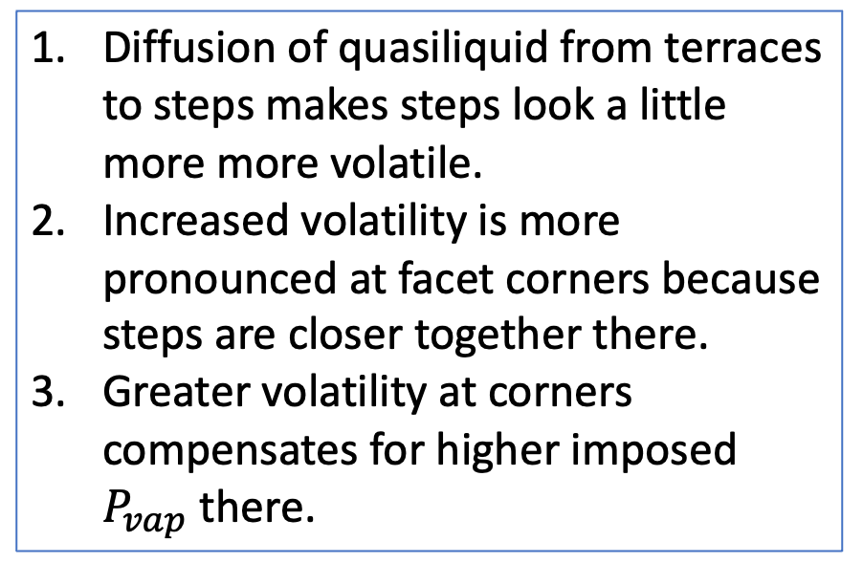
The mechanism behind stable limit cycles depends crucially on surface diffusion of QLL
Diffusion of quasiliquid from terraces to steps makes steps look a little more more volatile.
Increased volatility is more pronounced at facet corners because steps are closer together there.
Greater volatility at corners compensates for higher imposed $P_{vap}$ there.

Slide 35
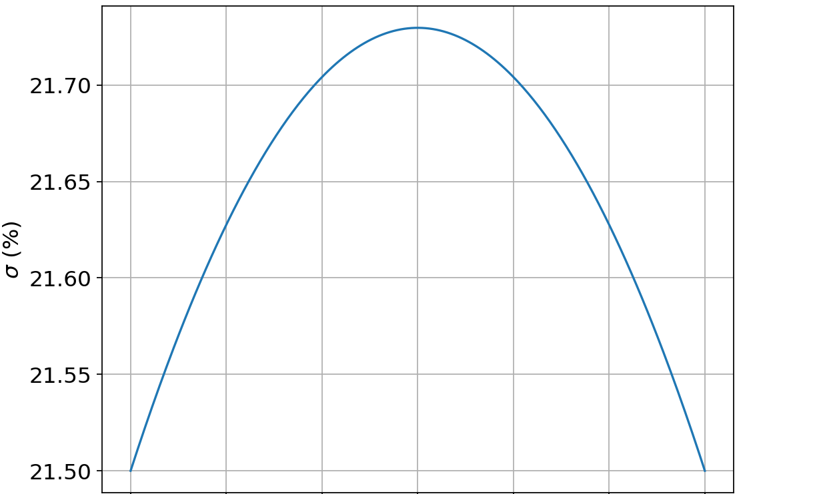
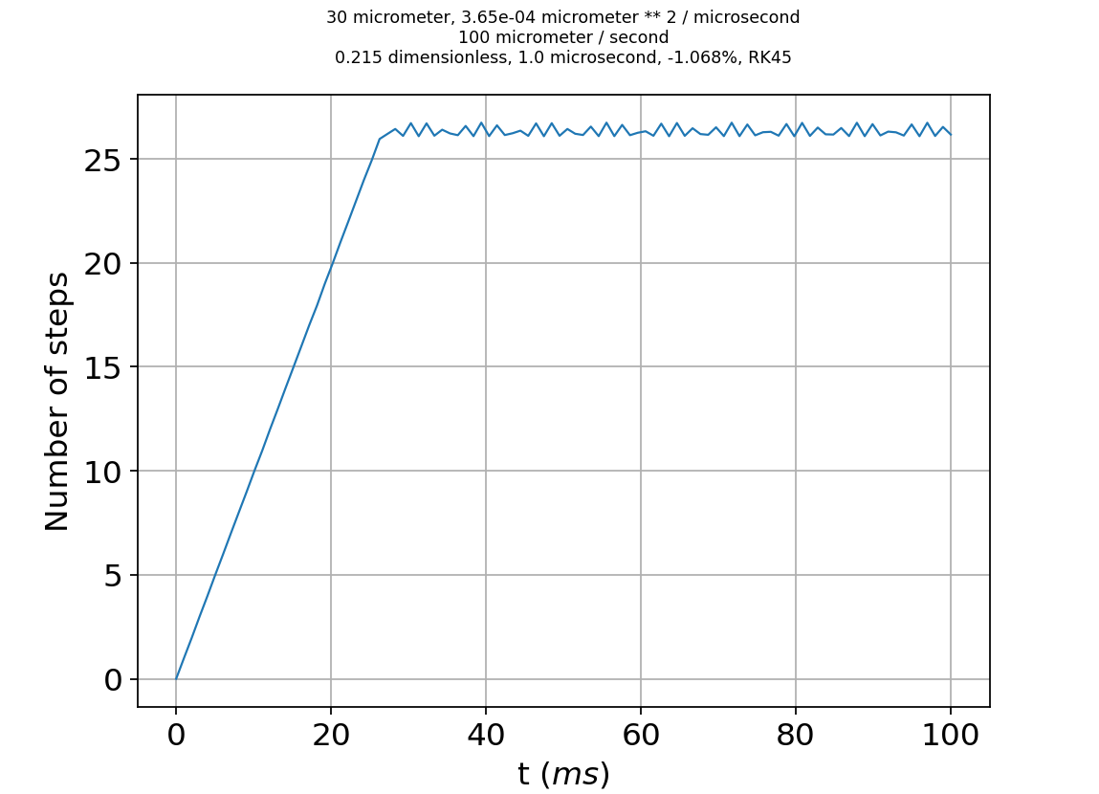
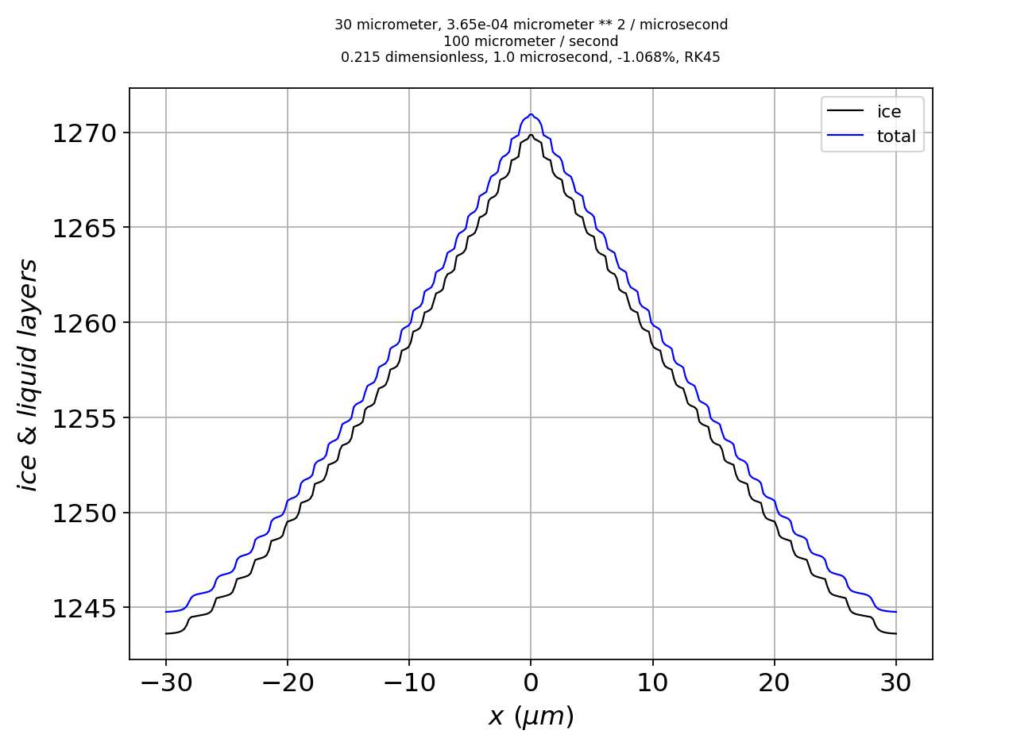




Limit cycles can accommodate various inhomogeneities in the overlying vapor field
Imposed supersaturation
Max-min number of layers over time
Shape of the converged surface
Higher $P_{vap}$ at facet corners
Limit cycle has convex curvature
Limit cycle reached at $35 ms$
Higher $P_{vap}$ at facet center
Limit cycle reached at $25 ms$
Limit cycle has concave curvature

Slide 36
Take-home lesson from Part 1: limit cycling explains faceted growth
Depth of the surface stops changing
1. Faceted growth is the result of stable limit cycles, whose occurrence is an emergent property of the dynamics of ice growth.
2. The mechanism leading to this emergence is generic in the sense that the facet surface is modified to compensate for any smooth inhomogeneity in the overlying vapor field.

Slide 37
On to Part II
$$mesoscopic scale$$
(from scanning electron microscopy)
Part I:
How do surfaces get rough? Actually, how do surfaces remain smooth?
Part II:
What controls the roughness? Actually, what is roughness?
Molecular scale

Slide 38
Hypothesis: maybe roughness is “just” microfacets of other angles

Slide 39



Why? Optical microscopy tells us there are characteristic peak-to-peak distances
Crystal habit (columns vs plates)
Hollowing
Roughness
Regarding those stripes (roughness):
The peak-to-peak distance is $\sim 15 μ$m
The vertical relief is (sadly) indeterminate

Slide 40




SEM/GNBF gives us the angles too
Horizontal Peak-to-peak distance $\sim 50 μ$m
Vertical relief $\sim 7 μ$m
=> Slope $\sim 10°$

Slide 41



SEM/GNBF gives us the angles too
Horizontal Peak-to-peak distance $\sim 15 μ$m
Vertical relief $\sim 1−2 μ$m
=> Slope $\sim 10°$

Slide 42

Modifying our PDE to enable microfaceting …
Ice surface
Prismatic monolayer ($h_{pr})$

Slide 43


Red lines indicate successive layers of a different crystallographic plane, of thickness $h_{θ}$
$$h_{θ}$$
$$θ$$
We’ll refer to this new crystallographic plane “pyramidal” or “$θ$-like”

Slide 44

Red lines indicate successive layers of a different crystallographic plane, of thickness $h_{θ}$
$$h_{θ}$$
$$θ$$
We’ll refer to this new crystallographic plane “pyramidal” or “$θ$-like”

Slide 45


Our strategy: keep the form of the PDE, but make key parameters (${\tilde{σ}}_{m}$ and ${\tilde{N}}_{QLL}^{eq}$) dynamic
$$θ$$
$\frac{{∂N}_{tot}}{∂t}={c_{δ}^{2}D}_{QLL}∇^{2}N_{QLL}+ν_{kin}$ $σ_{m}$
$\frac{{∂N}_{QLL}}{∂t}=\frac{{∂N}_{tot}}{∂t}−\left(N_{QLL}−N_{QLL}^{eq}\right)/τ$
$\frac{{∂N}_{tot}}{∂t}={c_{δ}^{2}D}_{QLL}∇^{2}N_{QLL}+ν_{kin}$ ${\tilde{σ}}_{m}$
$\frac{{∂N}_{QLL}}{∂t}=\frac{{∂N}_{tot}}{∂t}−\left({∂N}_{QLL}−{\tilde{N}}_{QLL}^{eq}\right)/τ$

Slide 46

For ${\tilde{N}}_{QLL}^{eq}$: First we need to compute the layer thicknesses ($N_{tot}$) at each grid point
$$θ$$
At the dot, $N_{tot,pr}=3$ and $N_{tot,θ}=2$
More generally, $N_{tot,±θ}(x)=\frac{1}{h_{θ}}\left(c_{θ}h_{pr}N_{tot,pr}±s_{θ}x\right)$

Slide 47

For ${\tilde{N}}_{QLL}^{eq}$: $N_{tot}(x)$ gets us equilibrium QLL thicknesses for any given facet angle
$$θ$$
$N_{QLL,pr}^{eq}(x)=\overline{N}−N_{pr}^{∗}sin⁡(2πN_{tot,pr}(x))$
$N_{QLL,±θ}^{eq}(x)=\overline{N}−N_{±θ}^{∗}\sin\left(2πN_{tot,±θ}(x)\right)$

Slide 48
For ${\tilde{N}}_{QLL}^{eq}$: Then we’ll weight them (“$α$”)
$$θ$$
$${\tilde{N}}_{QLL}^{eq}(x)={{α_{θ}N}_{QLL,θ}^{eq}\left(x\right)+α_{pr}N}_{QLL,pr}^{eq}\left(x\right)+{α_{−θ}N}_{QLL,−θ}^{eq}(x)$$

Slide 49

For ${\tilde{σ}}_{m}$: Each facet angle gets an $N^{∗}$ and $σ_{o}$
$$θ$$
$σ_{m,pr}\left(x\right)=σ_{I}\left(x\right)−\frac{N_{QLL}(x)−\left(\overline{N}−N_{pr}^{∗}\right)}{2N_{pr}^{∗}}σ_{o,pr}$
$σ_{m,±θ}\left(x\right)=σ_{I}\left(x\right)−\frac{N_{QLL}(x)−\left(\overline{N}−N_{±θ}^{∗}\right)}{2N_{±θ}^{∗}}σ_{o,±θ}$

Slide 50
For ${\tilde{σ}}_{m}$: Then we’ll weight them (“$α$”)
$$θ$$
${\tilde{σ}}_{m}={α_{θ}σ}_{m,θ}+α_{pr}σ_{m,pr}+{α_{−θ}σ}_{m,−θ}$

Slide 51


We need those weights $α_{±θ}$ & $α_{pr}$
Slopes: $\frac{dz_{pr}}{dx}≡β$
$$θ$$
Each grid point has a slope ($β$)

Slide 52
Assign the weights according to the slope of the surface
Slopes: $\frac{dz_{pr}}{dx}≡β$
$$θ$$
Here, $β≈β_{θ}$, so the grid point aligns with the positively-sloped $θ$ (“pyramidal”) facet

Slide 53
Assign the weights according to the slope of the surface
Slopes: $\frac{dz_{pr}}{dx}≡β$
$$θ$$
Here, $β≈0$, so we’d say the grid point aligns best with the original facet (prismatic)

Slide 54
Assign the weights according to the slope of the surface
Slopes: $\frac{dz_{pr}}{dx}≡β$
$$θ$$
$β≈{−β}_{θ}$ so the grid point aligns with the negatively-sloped $θ$ facet

Slide 55






Assign weights using sigmoid functions ($α_{θ}$, $α_{pr}$, $α_{−θ}$)
$$α_{θ}≈0.9$$
$α_{pr}$ $≈0.1$
$α_{−θ}≈0.0$
$$α\left(β\right)=1−\frac{1}{1+e^{−\frac{β−β_{θ/2}}{∆β}}}$$
$${−β}_{θ/2}$$
$$0$$
$$β_{θ/2}$$

Slide 56
Each grid point can now be assigned a set of weights ($α_{pr}$, $α_{θ}$, $α_{−θ}$)
$$α_{θ}≈0.9$$
$α_{pr}$ $≈0.1$
$α_{−θ}≈0.0$
$$θ$$

Slide 57

Using the weights ($α$), we compute weighted averages
$$α_{θ}≈0.9$$
$α_{pr}$ $≈0.1$
$α_{−θ}≈0.0$
$$θ$$
${\tilde{σ}}_{m}={α_{θ}σ}_{m,θ}+α_{pr}σ_{m,pr}+{α_{−θ}σ}_{m,−θ}$
(similar for ${\tilde{N}}_{QLL}^{eq}$)

Slide 58
Now we have all the pieces needed to explore dynamics of the microfacet-enabled model
$$θ$$
$\frac{{∂N}_{tot}}{∂t}={c_{δ}^{2}D}_{QLL}∇^{2}N_{QLL}+ν_{kin}$ $σ_{m}$
$\frac{{∂N}_{QLL}}{∂t}=\frac{{∂N}_{tot}}{∂t}−\left(N_{QLL}−N_{QLL}^{eq}\right)/τ$
$\frac{{∂N}_{tot}}{∂t}={c_{δ}^{2}D}_{QLL}∇^{2}N_{QLL}+ν_{kin}$ ${\tilde{σ}}_{m}$
$\frac{{∂N}_{QLL}}{∂t}=\frac{{∂N}_{tot}}{∂t}−\left({∂N}_{QLL}−{\tilde{N}}_{QLL}^{eq}\right)/τ$

Slide 59




Limit cycling without microfaceting
Notes: The trajectory indicates a limit cycle is achieved after about $200 ms.$

Slide 60





Limit cycling with microfaceting
Notes: The trajectory indicates a limit cycle is achieved after about $200 ms$. Evidence of microfaceting is seen in the early stages of $N_{QLL}$ profile development, here at 27 ms. Results are very similar when sigma0factor is increased to 1.2, which leads to no-growth microfacets.

Slide 61





Growable $θ=±5°$ microfaceting, fast-growth conditions
Notes: Switched to a bigger scale for $N_{tot}$ here. The trajectory indicates a limit cycle after about $3 s$, with a variability in $N_{QLL}$ expected of pyramidal facets (i.e., up to $N+N_{py}^{∗}≈1.09$, but frequently dipping to as low as $1.05$).

Slide 62





Non-growable $θ=±5°$ microfaceting, fast-growth conditions
The only difference here is that the $±5$ microfacets have a higher value of $σ_{o}$, such that they cannot grow, which explains both the smoothness of $N_{tot}$ and the lack of variability of $N_{QLL}$ (i.e., hovering around $1.08$). The trajectory indicates a steady state is achieved by about $1.3 s$.

Slide 63





Non-growable $θ=±10°$ microfaceting, different fast-growth conditions
Also a static profile
$${h_{pr}N}_{tot,pr}$$

Slide 64




Non-growable $θ=±10°$ microfaceting, fast-growth conditions
Also a static profile
$${h_{pr}N}_{tot,pr}$$

Slide 65






Non-growable $θ=±20°$ microfaceting, fast-growth conditions
The vertical scale is about twice the $θ=±10°$ case we just saw
$${h_{pr}N}_{tot,pr}$$

Slide 66





Non-growable $θ=±30°$ microfaceting, fast-growth conditions
Vertical scale is about about three times the $θ=±10°$ case
$${h_{pr}N}_{tot,pr}$$

Slide 67


Take-home lessons
From Part I:
1. Faceted ice growth is the result of stable limit cycles, whose occurrence is an emergent property of the dynamics of ice growth.
2. The mechanism leading to this emergence is generic in the sense that the facet surface is modified to compensate for any smooth inhomogeneity in the overlying vapor field.
From Part II:
1. Roughness is consistent with microfacet formation modulating otherwise flat faceted surfaces.
2. Microfacets stabilize the surface in that they enable limit cycle profiles when the microfacets are supersaturated, or static profiles when undersaturated.
3. Available in situ (visible, SEM/GNBF) experiments suggest a predominance of $θ≈10°$ microfacet on prismatic facets in the principle (c) axis direction.

Slide 68


Can we use this theory to usefully predict statistics of ice facet roughness?
There are SEM and in situ cirrus cloud observations to compare to, so that’s good. But there are lots of outstanding questions …
How does microfaceting (hence, roughness) depend on other parameters, like the imposed supersaturation and temperature?
What about multiple microfacet angles ($±θ_{1}$, $±θ_{2}$, etc.)?
What about two-dimensional crystal surfaces?
What about rimming and hollowing?
What happens in subsaturated conditions? (So far, we have computational results only for mildly supersaturated conditions.)
How good is the assumption that the imposed vapor field varies with positive curvature for growing crystals?

Slide 69

We do get positive curvature on “flat” basal facets, although it’s a lot bigger and bumpier than stable limit-cycle theory predicts

Slide 70


The beginnings of hollowing when $ν_{kin}$ gets big (higher temperature)
$$≈0.2 μm$$

Slide 71




Molecular Dynamics studies of ice surfaces
December 2016

Slide 72



$θ=±10°$ microfaceting enabled, after 10 seconds simulated time (w/o D correction)
The vertical scale is in $μm$ here, x1000s greater than what I showed you before; it would be visible on a microscopic (e.g., SEM) scale.
It would develop a steady state.
$${h_{pr}N}_{tot,pr}$$

